Slide 1
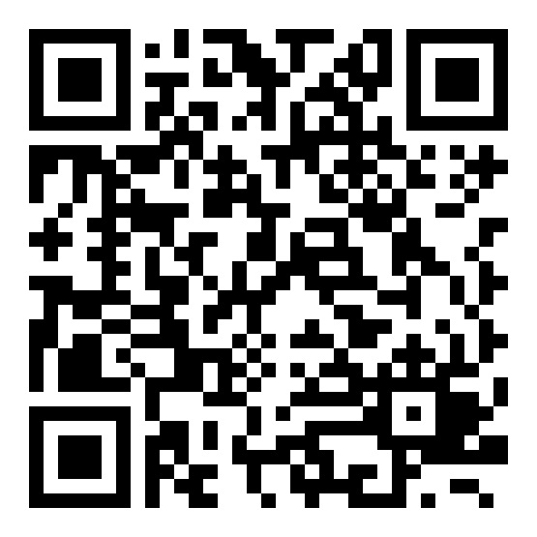
Course evaluation: Research Design and Methods in Quantitative Research
Evaluation period: 17 – 28 November 2025

